Slide 1

COVID-19
Outbreak response and investigation in Health Care Facilities
Kerrigan McCarthy
Consultant Pathologist
National Institute for Communicable Diseases
25 June 2020

Slide 2
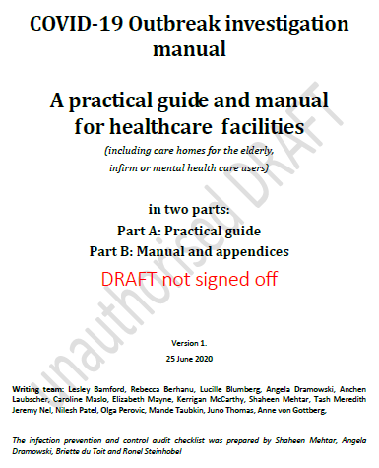

Source:
Will be on the NICD website from 26 June 2020 in the COVID-19 section

Slide 3
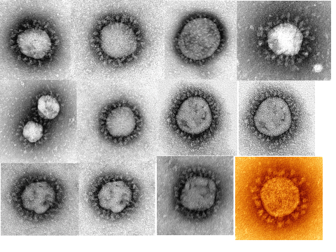
COVID-19 outbreaks in health care facilities
Broad principles and definitions
Steps in outbreak investigation and response
Leadership, co-ordination and communication and management of psychological responses
Initial responses
  Determination of the infectious period
  Identification of contacts
  Quarantine and isolation
Working up complex outbreaks
Prevention
Electron micrographs of SARS-CoV-2, grown in the NICD BSL-4 and photographed by Dr Monica Birkhead, NICD

Slide 4





Broad principles and definitions
It may not be possible to prevent COVID-19 from entering a facility, but we can
  Detect cases early
  Ensure that it is very difficult to transmit COVID-19 amongst staff and patients
COVID-19 is an undesirable organism in a health care facility
  COVID-19 infections in vulnerable persons can lead to excess morbidity and mortality
  Outbreaks cause immense disruption to health care services
All health care facilities (HCF) will be at risk of undetected COVID-19 infections (symptomatic and asymptomatic) during the COVID-19 pandemic

Slide 5
Broad principles and definitions
Health care facility
  A hospital, day ward, general practice, home for aged, indigent or mental health care users
Health care worker
  Any person who works on the premises of a health care facility
An Index case/s
  A HCW or patient who test positive for COVID-19
A Health-care associated outbreak
  Detection of a single or multiple laboratory-confirmed case/s in a HCW or patient where the diagnosis was not suspected on admission
A contact of a confirmed case
  A health care worker contact: any HCW in direct contact with a COVID-19 patient, within 1 meter for 15 minutes or longer, without appropriate PPE (mask and eye protection) and/or experienced failure of PPE.
  A contact who is a patient (or visitor) exposed during hospitalisation: any patient hospitalised in the same room or sharing the same bathroom as a COVID-19 patient, visitors to the patient, or other patient in the same waiting area or outpatient examination room who spent 15 minutes or longer within 1 meter with the index case;
  A contact who is a patient (or visitor) exposed during an outpatient visit: Anyone in a closed environment at the same time as a person with a confirmed diagnosis of COVID-19; or anyone within 1m of the COVID-19 patient in any part of the hospital for >15 minutes.

Slide 6
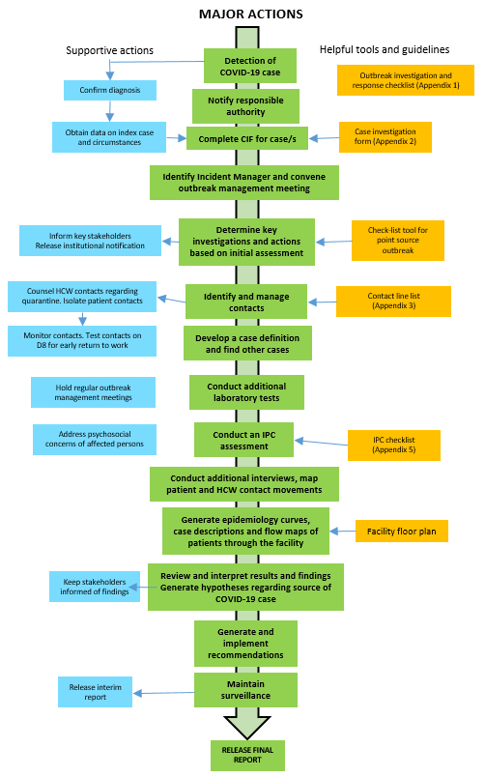
Steps in outbreak investigation and response
A roadmap
  What is required
  Where are we going?

Slide 7
Steps in outbreak investigation and response
A roadmap
  What is required
  Where are we going?

Slide 8
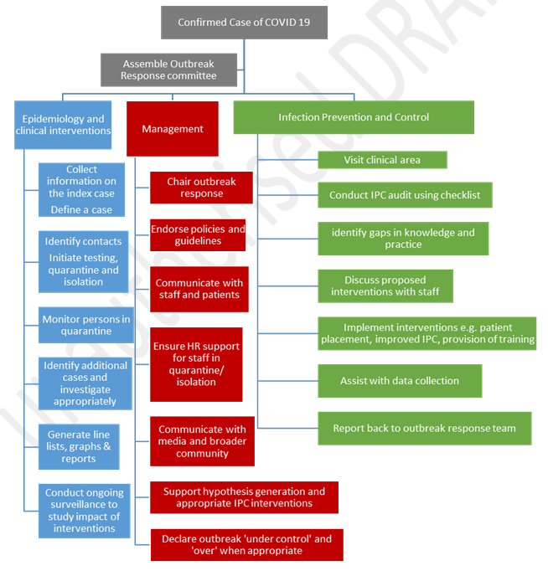
Steps in outbreak investigation and response
How do we co-ordinate and arrange outbreak responses?
  There are three major components to co-ordinate
    Epidemiology and clinical management
      Investigating the extent of cases
      Quarantine and isolation
      Putting the epidemiology together
    Co-ordination and management
      Leadership, communication, decision-making, staffing
    Infection prevention and control
      Assessment of IPC practices
      Identification of gaps in IPC
      Strengthening IPC practice

Slide 9
Leadership, co-ordination and communication
Leaders need to remember the aims of the investigation
  To identify source of outbreak so as to
  To contain and prevent further transmission,
  To identify gaps in and strengthen the IPC measures which facilitate early detection and response to a case of COVID in a health care facility
Leaders need to set the tone of the investigation
  Non-retributive – it’s not ‘someone’s fault’
  Co-operation is the name of the game ‘we can all work to keep everyone safe’
  Learn from our mistakes – ‘Let’s do it better next time’
  Empathetic – ‘this is very stressful for us all, here is how we can look after ourselves

Slide 10
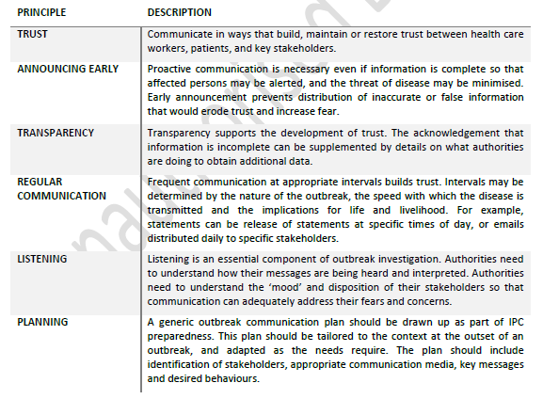
Leadership, co-ordination and communication
Communication is key
  WHO principles of communication in outbreaks
Identify stakeholders who need to know
  Especially staff, organised labour, and patients
First message to the institution within 12-24hrs
  What is known
  What is not known
  What authorities are doing
  What we can do to prevent infection and keep calm

Slide 11
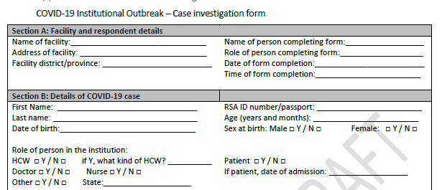
Initial responses: Convene the outbreak investigation committee and investigate the case
Convene the outbreak investigation committee
  Head of the facility (CEO/CMO)
  IPC specialist
  Senior matron
  A senior clinician/medical/ infectious disease specialist
  Housekeeping/cleaning services
  Data manager.
  Human resources
  Organised labour
Arrange to meet asap (within 12 hrs)
  Use a checklist for outbreak investigation as an agenda for the meeting
  Appendix 1 of NICD COVID outbreak guidelines’
Arrange for the index case/s to be investigated
  Dates of symptom onset, COVID-19 testing, admission, procedures
  Locations in the health facility on these dates
Use Case investigation form from ‘NICD COVID outbreak guidelines’, Appendix 2

Slide 12
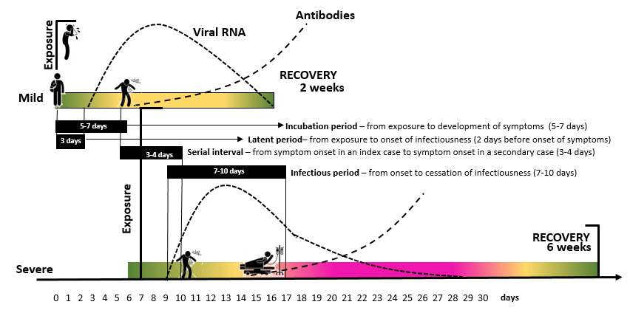
Initial response: Determine the infectious period
A person is deemed infectious for 48 hrs before symptom onset (or test date if asymptomatic), until 14 days post symptom onset
Determine the
  dates that the person was in the facility whilst infectious
  Where the person was on those dates
Use these dates to determine who the contacts are

Slide 13
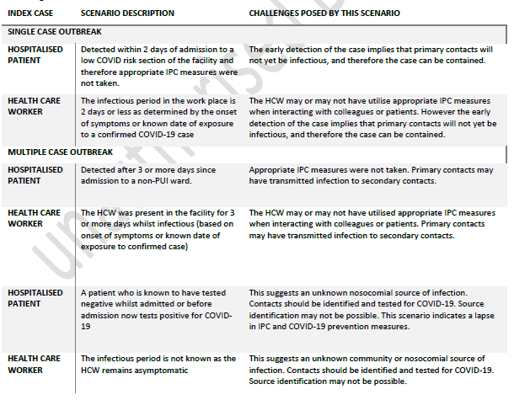
Initial response: Implications of the infectious period
Critical
  Was index case in the facility for less than 3 days whilst infectious?
  If yes….
    Less complicated scenario as there has been no time for onward transmission
  If no….onward transmission is likely

Slide 14
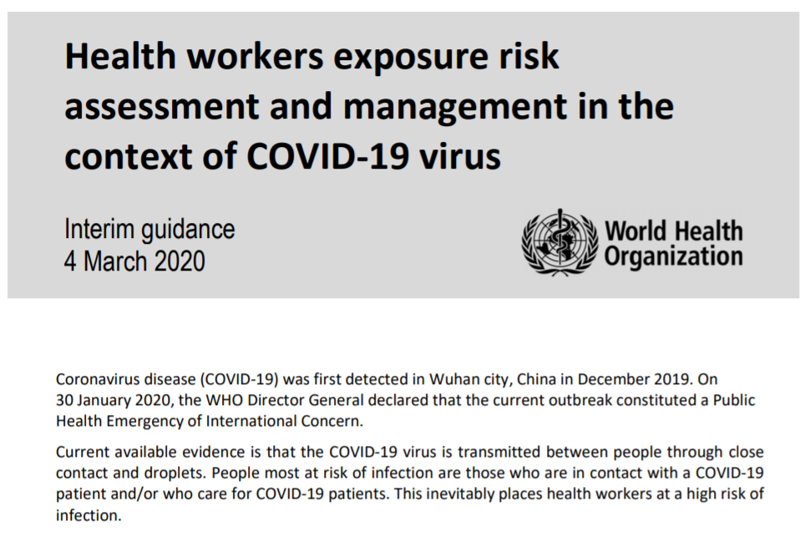
Initial response: Identification and management of contacts
Identification of all persons in contact with the case whilst infectious
Conduct a risk assessment for each using WHO tool
  Close contact – not using PPE correctly AND within 1m for 15 minutes, OR direct touch of patient
  ‘Low-risk contact’ – using PPE correctly with any kind of contact, or not meeting the above definition
Assessment of symptoms in contact
  All symptomatic contacts must be tested asap, and put into isolation
  Asymptomatic contacts need to be tested ONLY if the infectious period is >2 days
https://apps.who.int/iris/bitstream/handle/10665/331340/WHO-2019-nCov-HCW_risk_assessment-2020.1-eng.pdf

Slide 15
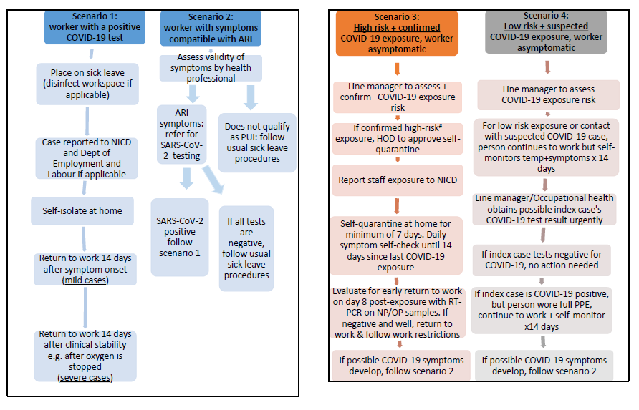
Initial response: Identification and management of contacts
https://www.nicd.ac.za/diseases-a-z-index/covid-19/covid-19-guidelines/symptoms-monitoring-and-management-of-essential-workers-for-covid-19-related-infection/

Slide 16
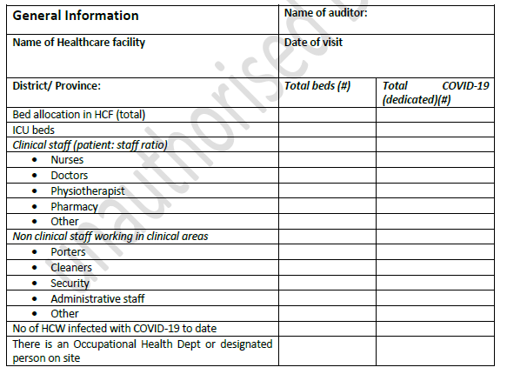
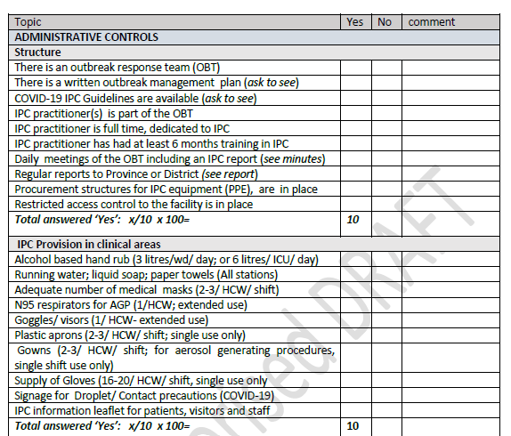
Initial response: Conducting an Infection Prevention and Control audit
Visit the affected wards with IPC co-ordinator
  Review the following components of IPC
    Administrative
    Environmental
    PPE
Identify gaps
Propose immediate short-term recommendations
Appendix 6 in NICD COVID-19 Outbreak guidelines on NICD website from tomorrow.

Slide 17
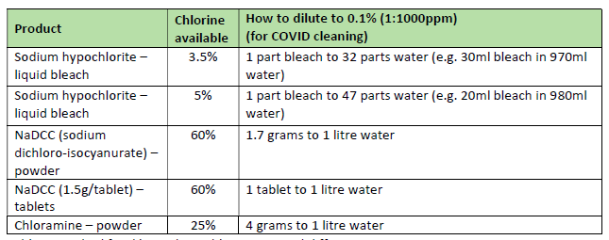
Initial response: Conducting an Infection Prevention and Control audit
Cohorting and moving patients and HCW
  COVID-19 positive patients
    Isolate all patients who are COVID-positive and infectious
    If >1 patient is COVID-19 positive, these can be cohorted
  Exposed patients (i.e. who are contacts)
    Isolate for 14 days, issue with masks
    Monitor for symptoms
    Cohorting NOT advised
Environmental decontamination
  Wipe down frequently touched surfaces.
  Defogging not necessary

Slide 18
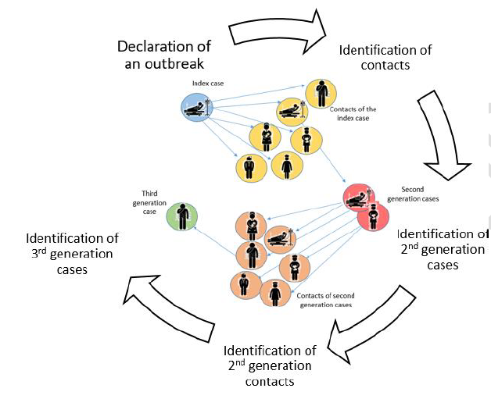
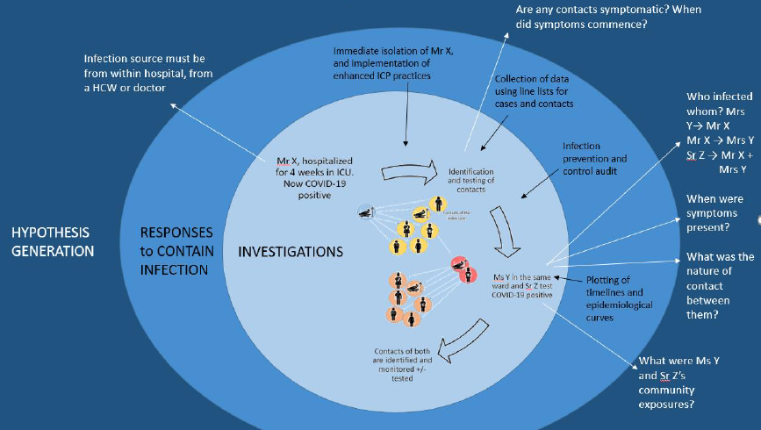
Working up complex outbreaks
If index patient/s have been infections and in the health care facility for >2 days, onward transmission may have occurred
All CLOSE contacts should be swabbed for COVID-19
A line list should be made
An epidemiological curve should be created
Generate hypotheses regarding possible sites of infection and ask more questions

Slide 19
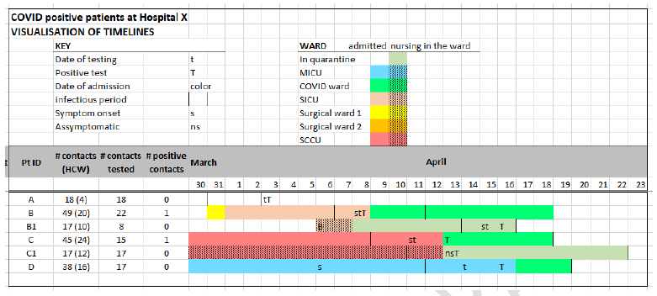
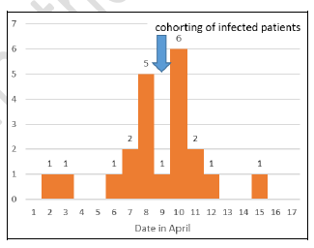
Working up complex outbreaks
Put these together with IPC audit findings to generate hypotheses to identify where the breach in IPC took place

Slide 20
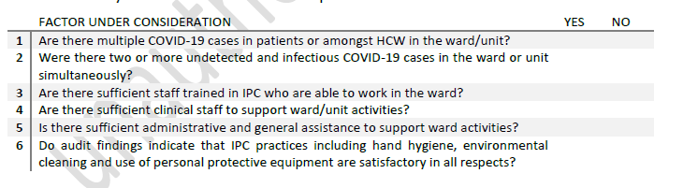
Working up complex outbreaks: ward, unit or facility closure?
Ward/unit closure and definitely facility closure is an extreme measure
Consider the following before closure: (2 or more ‘yes’ answers would make closure a consideration

Slide 21
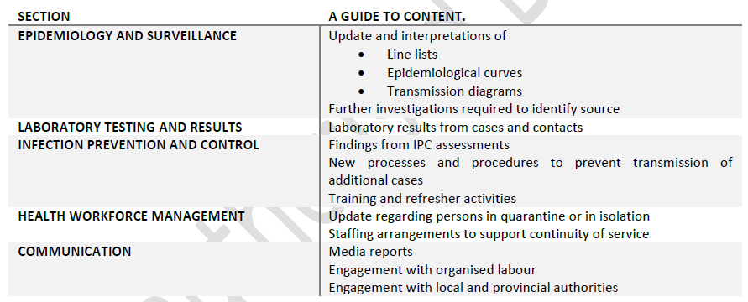
Reporting and declaring the outbreak closed
An outbreak may be ‘closed’ when 2 successive incubation periods have passed without a new case being detected
  Assuming adequate surveillance and detection methodology in place
BUT
  During the pandemic, no facility is essentially ‘free of risk’ as cases may continually be brought into the facility from the community
Daily, interim and final outbreak reports
  Daily summaries from the Outbreak Response team lead
  Interim report once the outbreak is decleared over
  Final report once all data is in, and hypotheses are closed

Slide 22
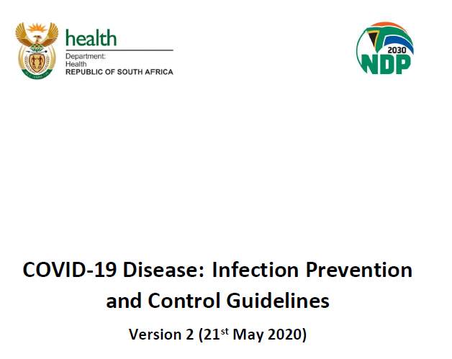
Prevention is key
Administrative controls
Environmental controls
Personal protective equipment and risk reduction
Understanding risks to your facility
The decision where to screen your patients?
How to screen patients
Who will screen patients
Procedures for management of persons who meet case definitions for testing
Is testing for COVID-19 in this facility necessary or shall I refer clients to a lab?
Ensuring adequate ventilation
Cleaning the environment
Provision of appropriate equipment and tools
When to wear what masks
Encouraging handwashing
Procedures for IPC when collecting specimens.
https://www.nicd.ac.za/wp-content/uploads/2020/05/ipc-guidelines-covid-19-version-2-21-may-2020.pdf

Slide 23
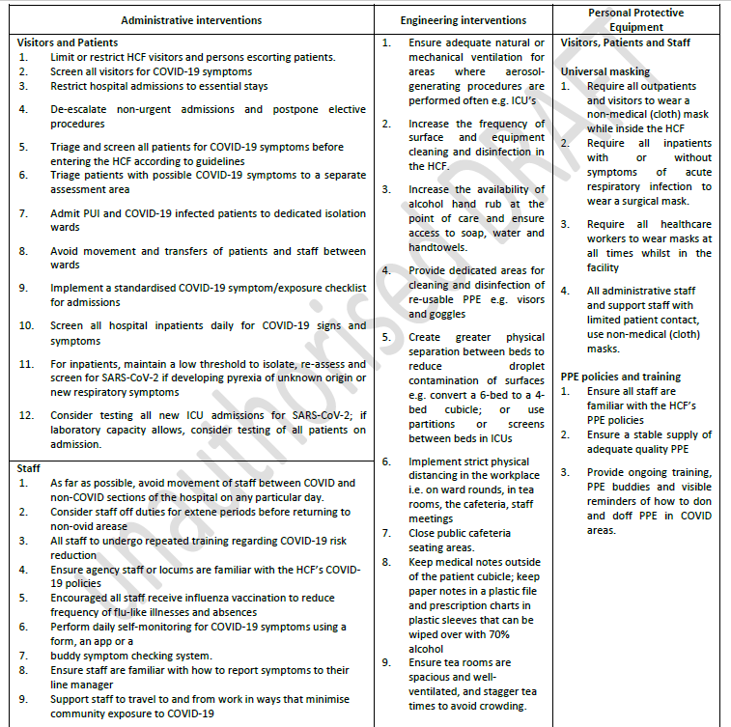
Prevention is key
The two-fold aims of prevention
  Early detection of cases
    Symptom screening for all staff on entry
    Consider random staff testing esp in high risk areas
    Pre-screening of elective admissions
  Making transmission in the facility difficult
    Social distancing
    Universal masking
    Hand sanitising
    Engineering interventions

Slide 24
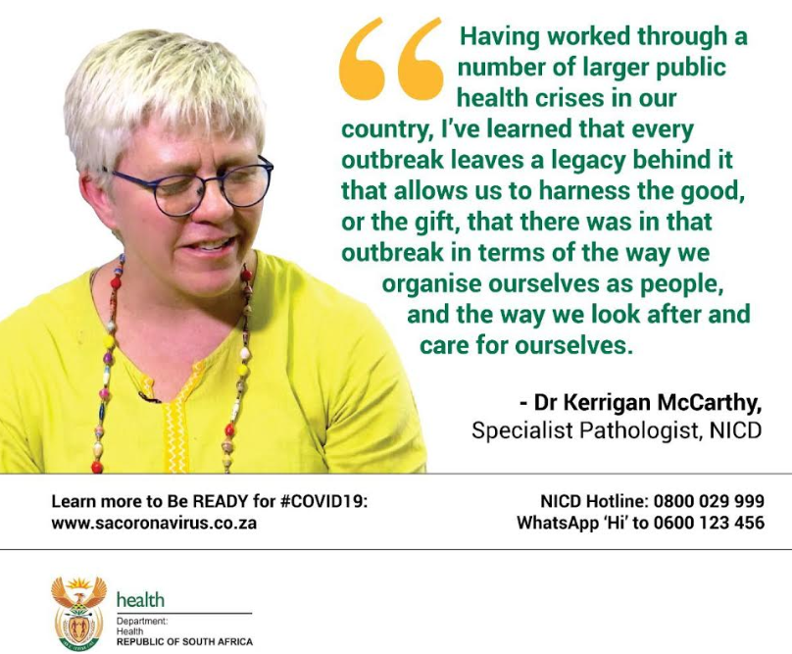
What are we learning?
Outbreaks and public health events have shown us
The people that service our health care system
  ARE responsive, and
  DO have capacity to change and adapt
  CAN do what is required if the motivation is sufficient
Preventive health services need major emphasis and investment.
Health promotion and wellness messaging is critical
Community engagement and ownership are essential to achieve co-operation with social distancing

Slide 25
Thank you
Acknowledgements: Lesley Bamford, Rebecca Berhanu, Lucille Blumberg, Angela Dramowski, Anchen Laubscher, Caroline Maslo, Elizabeth Mayne, Kerrigan McCarthy, Shaheen Mehtar, Tash Meredith Jeremy Nel, Nilesh Patel, Olga Perovic, Mande Taubkin, Juno Thomas, Anne von Gottberg

